Slide 1
ADABOOST ALGORITHM
LEARNING PPT

Slide 2
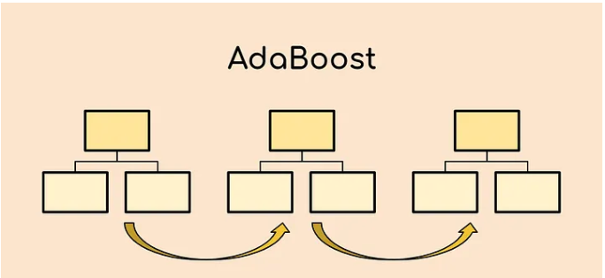
ADABOOST ALGORITHM
The AdaBoost algorithm, which stands for Adaptive Boosting, is a boosting strategy that is applied in machine learning as part of an Ensemble Method. It is given the name “Adaptive Boosting” because of the fact that the weights are reallocated to each instance, with higher weights being applied to instances that were mistakenly categorized. Boosting is an approach to supervised learning that can reduce bias while also reducing variance.

Slide 3
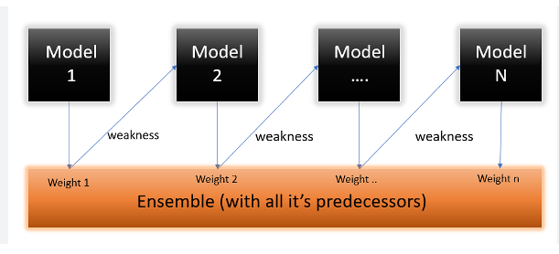
ADABOOST -Built on weaknesses of each model by improvising each model
Talking about the main idea behind the AdaBoost algorithm, we find that it iteratively trains a sequence of weak classifiers on different subsets of the training data. During each iteration, the algorithm assigns higher weights to the misclassified samples from the previous iteration, thereby focusing on the more challenging examples. This process allows the subsequent weak classifiers to pay more attention to the previously misclassified samples and improve their performance.

Slide 4

What are the benefits of AdaBoost?
The AdaBoost algorithm has several benefits:
The algorithm is simple to understand and implement.
The algorithm is versatile and can be used for a variety of tasks such as
regression, classification, and outlier detection.
The algorithm is highly effective and often achieves good results with
little data.
The algorithm is robust to overfitting and can be used with a
variety of weak classifiers.
What are the disadvantages of AdaBoost?
The AdaBoost algorithm does have a few disadvantages:
The algorithm can be sensitive to noisy data.
The algorithm can be slow to train.
The algorithm can be difficult to tune.

